Slide 1
New World ERP
What’s New in HR/Payroll in 2018.1 and 2019.1

Slide 2

Agenda
2018.1 MIU Patch Enhancements
2019.1 Release Enhancements
Web based Help Central
Notes:
3 things I would like to accomplish with this presentation
Share what’s new
Explain the value or why we did it
Give example of how it can be used

Slide 3
2018.1 MIU Patch Enhancements
ReadyForm Integration
HSA Open Enrollment
Payroll Warning for no FICA or Medicare Tax set up
Other Percent FLSA Calculations
Delete a Users Shared Reports
GL Distribution Report
ExecuTime Integration

Slide 4
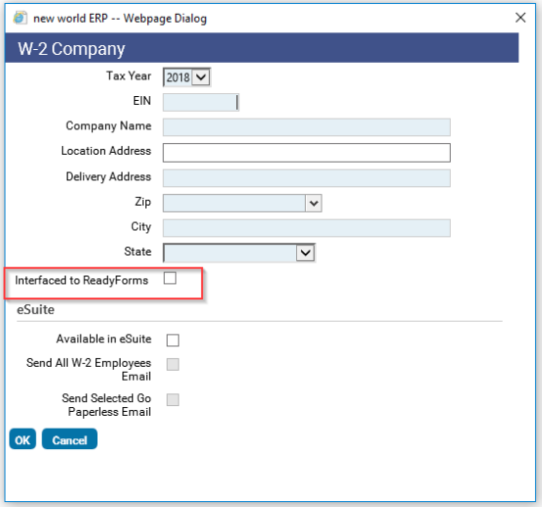
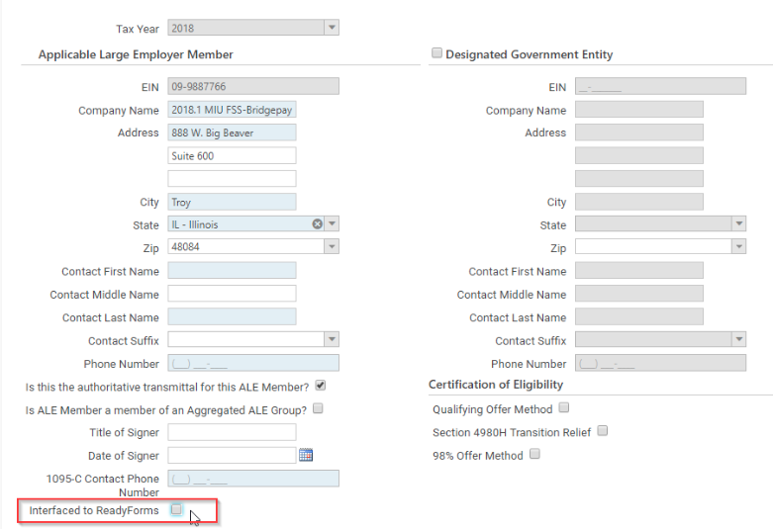
ReadyForm Integration for Year End
Interfaced to ReadyForms - W2
Interfaced to ReadyForms – 1095C
Notes:
ReadyForms are a standardized Tyler form that allows you to configure it. ReadyForms are very useful when using Tyler Content Manager (TCM)
What: We added new flags within the company setup for W2’s and 1095C’s that will allow users to toggle between creating Echo forms or ReadyForms.
Why: The payroll checks allow for selection of which form to print, echo or ReadyForm, whereas W2 and 1095C did not.
ReadyForms are auto stored in TCM, but we wanted to give users the same flexibility with Year End as payroll checks.

Slide 5
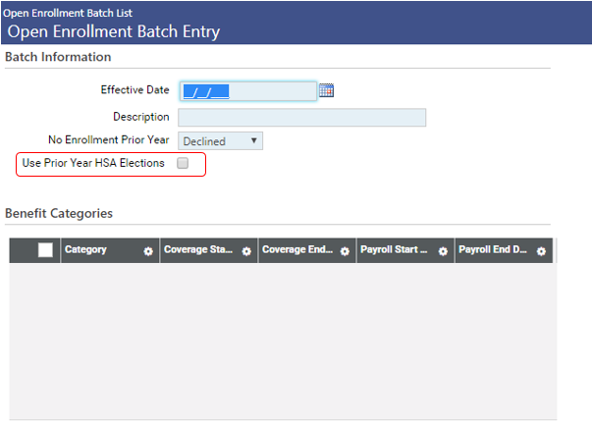
HSA Open Enrollment
Notes:
What: This is the new flag when creating a new Open enrollment batch called Use Prior Year HSA Elections.
Allows you to use the employees previous years enrollment for the new enrollment
Why? Med and HSA are required to be in the enrollment batch together, you cannot do open enrollment for only one or the other. You will still have to include both plans for open enrollment but what if you have a change to your medical plan mid year? You would want to run an open enrollment to reflect the new changes.
Example: You will not want to re-enroll everyone in HSA, now you can carry over their enrollment so you don’t have to. See the next screen for the field we carry over.

Slide 6
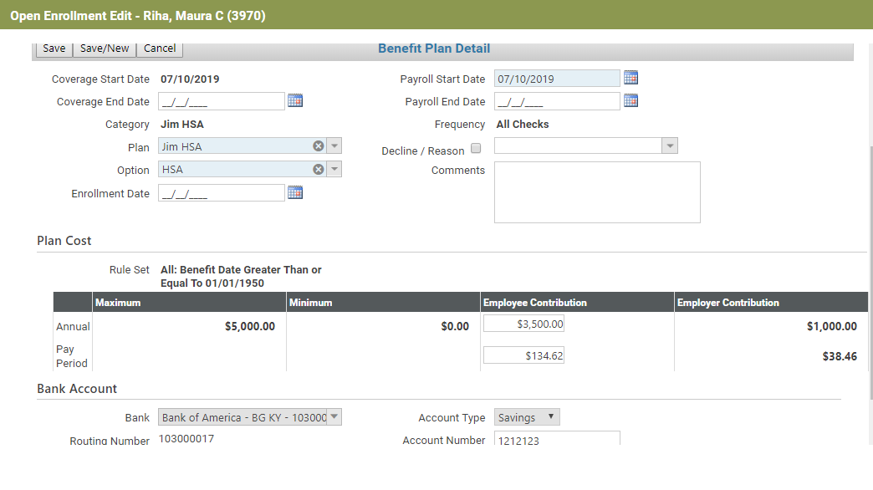
HSA Open Enrollment
Notes:
Results? We have enrollment amounts from last year. (with the bank information as well)
We keep your Bank, routing number, bank account, account type, and employee contribution.

Slide 7
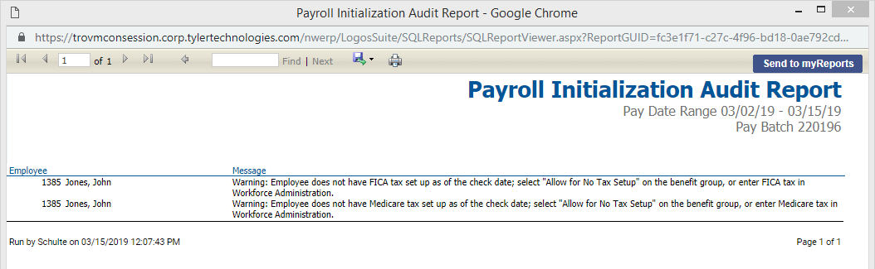
Warning For No FICA/Medicare Tax Setup
Notes:
What? Added a new validation to the Payroll Initialization Audit report that will identify employees missing FICA or Medicare.
Already did this for Fed tax, so we incorporated the FICA MED
Just a reminder with the next screen shot that FICA and Med tax are all incorporated with the FED tax setup.

Slide 8
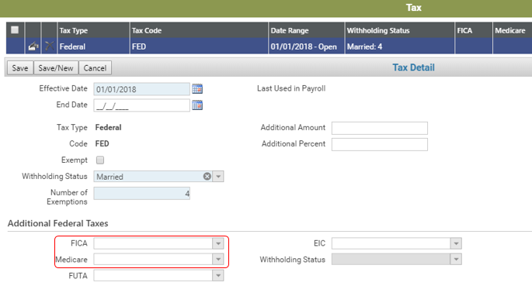
Warning For No FICA/Medicare Tax Setup
Notes:
Why?
Have you ever forgotten to add FICA or Medicare tax when adding Fed Tax?
We already verify if you are missing Fed tax, but what about FICA or Medicare?
We added a validation to the payroll initialization report that identifies employees with missing FICA or Medicare Tax along with Federal tax now.
Next slide shows how to remove this validation on the initialization report.
[Taxes are defined on each employee’s Workforce Administration record. Human Resources > Workforce Administration > search for an employee > select the employee’s hyperlink > Payroll Data tab > Taxes]

Slide 9
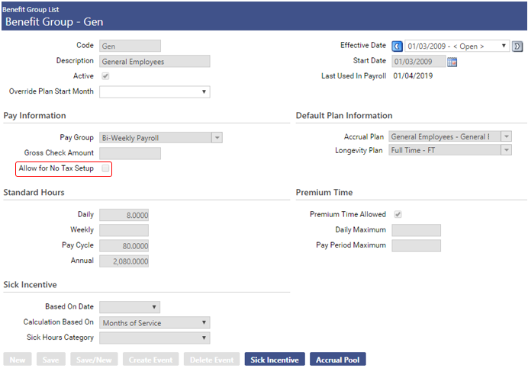
Warning For No FICA/Medicare Tax Setup
Notes:
We can eliminate this validation by selecting this flag on the benefit group. In same cases there are employees that are not subject to FICA and we can suppress these warning from showing up on the report. This flag will suppress warnings for all missing tax setup for Fed, FICA, and Medicare.
[Benefit Groups are located in Maintenance > Human Resources > Employee Attributes > Benefit Groups]

Slide 10
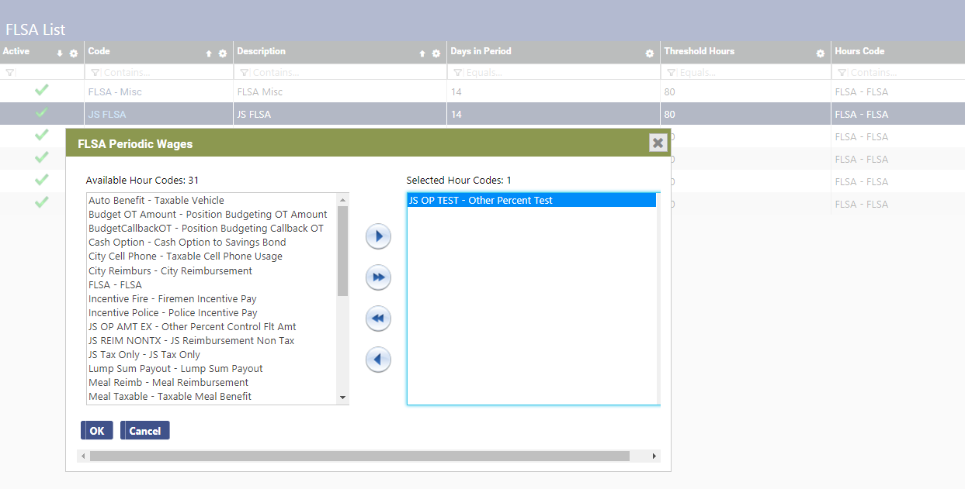
Other Percent FLSA Calculation
Notes:
What does this mean? This means we added the functionality of incorporating hours codes with a calc type of “other percent” into the Standard FLSA calculation. (no changes to setup or UI)
Why? This allows for more flexibility with time entry in combination with FLSA
[FLSA (Fair Labor Standards Act)- set up: Maintenance > Human Resources > Earnings Maintenance > FLSA]

Slide 11
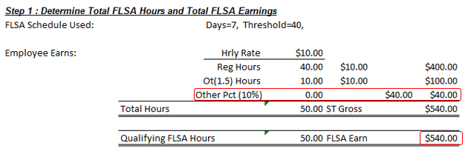
Other Percent FLSA
Notes:
Make sure payroll is validated so we can get the flat amount.
It will be treated the same as any “other amount”
Example: Education Incentive that is 5% of gross. Setup as hours code as other percent. This will now be calculated in FLSA as if it were a flat amount.
See next screen shot for the calculation. It the same but now we can incorporate the other percent.
formula will be used to determine the FLSA gross where Other Percent did not get included before this update.

Slide 12
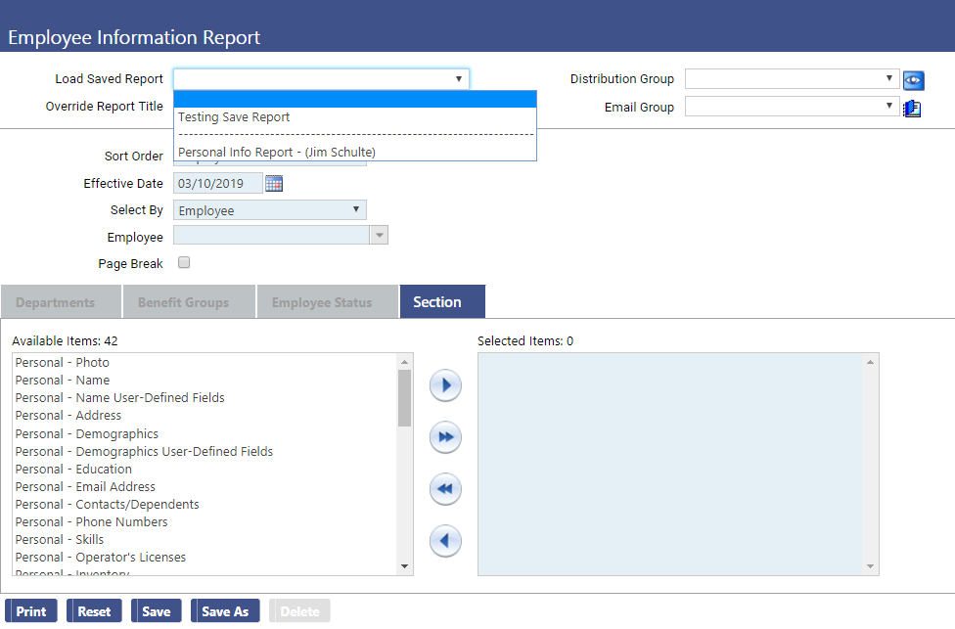
Delete Users Shared Reports
Notes:
We allow administrators to delete shared reports created by other uses
Why? In 2018.1, since managers can't change passwords to log in under other users' accounts, there's no way to delete Saved Reports
Example: User is now inactive and the cannot remove a shared report. It may no longer be useful or we may not want to reference that user name anymore.
Load the saved report and hit delete.

Slide 13
GL Distribution Report
Human Resources – Reports – Earnings Reports– GL Distribution Report
  Provides the extensive detail of how payroll expenses post to the General Ledger. This includes:
    Employee Name/Number
    Position Title/Number
    Department
    Benefit Group
    GL Account
    Project, GL Date
    Check Date
    Pay Group/Batch Number
    Source Type/Code/Description
Notes:
What is it? New Report that provides detailed payroll data.
Why did we do it? This helps combine a unique set of data into one table that will be extremely valuable for the finance user who deals with payroll.
Example of its uses on next slide, lets take a look at some results.
The permission for this report is “G/L Distribution Report”
The report is located [Human Resources > Reports > Earnings Reports > G/L Distribution Report]

Slide 14
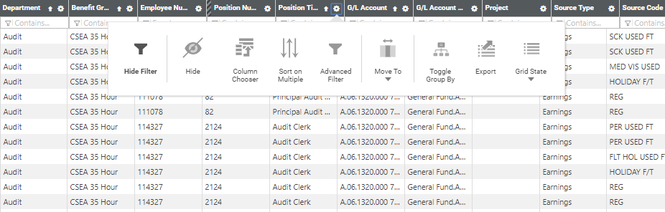
GL Distribution Report
  Results are returned in grid format which can be filtered, sorted and exported to Excel
Notes:
You can filter and sort in the grid or just export to MS Excel and filter and sort from there.
The detailed information is available the day after a payroll batch is posted. Help Central – has a great section on this area; https://nwerphelp.tylertech.com/nwerp_help_2018.1/Content/Human%20Resources/Reports/Earnings%20Reports/GL%20Distribution%20Report.htm?cshid=7201

Slide 15
ExecuTime Integration
New World ERP - ExecuTime “As One” Integration is here!
Automatically updates ExecuTime with changes in NWERP
This includes:
  Positions
  Hours Codes
  Departments
  Projects
  Employee Data
  Accrual Hours
Notes:
What Does it do?
Passes information from NWERP to ExecuTime automatically.

Slide 16
ExecuTime Integration
Benefits of the As One Integration
Saves Time
  Only need to update one application instead of two
Enhanced Data Integrity
  Reduced risk of entering data differently between the applications
No more payroll file imports
  Payroll hours will load directly into NWERP
Notes:
Why did we do it?
Saves time by reducing the amount of data entry into 2 different systems.
Enhanced data integrity, will reduce any errors resulting for data being entered differently between systems.
No more payroll import files. Payroll hours can be sent directly to NWERP from ExecuTime without the need to save a file to a shared location.
Basic setup on next screen.

Slide 17
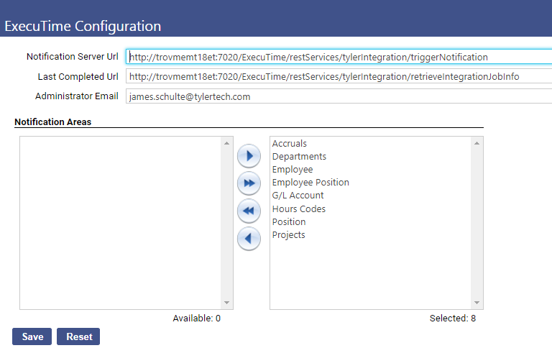
ExecuTime Integration
Notes:
Some basics of the integration will require a few URLs to be populated in the software. We have a new setup page for the integration that will require the user to populate the location of the Executime server in order to communicate with it. We also have the ability to subscribe to the certain areas we want to integrate with. Not all areas are required. The optional areas include Accruals, Employee Positions, GL Accounts, Positions, and Projects. Below are a few screen shot of what the integrated systems will look like side by side.

Slide 18
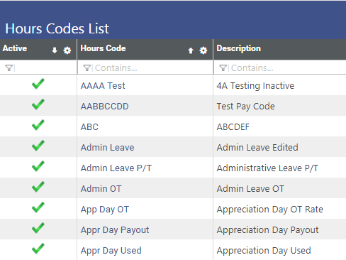
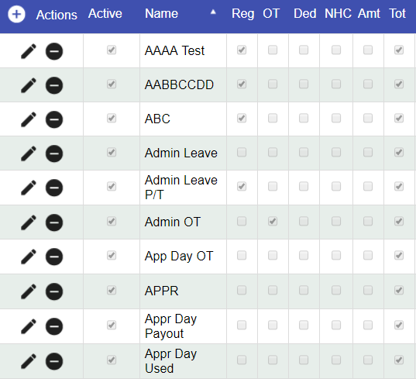
ExecuTime Integration
NWERP Hours Codes
ExecuTime Pay Codes
Notes:
Hours codes

Slide 19
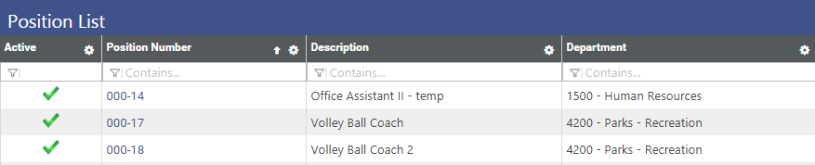
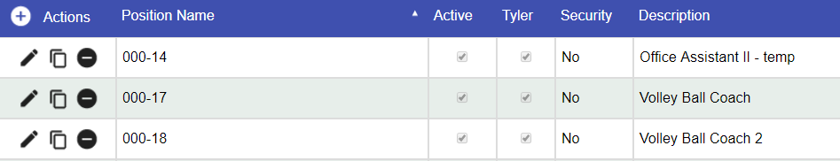
ExecuTime Integration
NWERP Positions
Positions in ExecuTime
Notes:
Positions

Slide 20
ExecuTime Integration
  Employee
  Name and Number
  Email Address
  Employment Status
  Date of Birth
  Pay Type (hourly or Salary)
  Pay Group
  Department
  Position
  Accrual Balance
  Hour Category
  Update Balance
  Projects
  Parent
  Child Project
  Department
  Structure
Notes:
Just wanted to share some more info about these areas.
Accruals are updated upon posting any payroll or adjustment
Available projects are always the highest level, meaning we do not use the parent, its always the sub-project available
Departments use components, the components are used to build the structure, we pass the structure to ExecuTime
Now we have the integration points, there is one more piece that we will talk about. That is the hours passed to NWERP from Executime

Slide 21
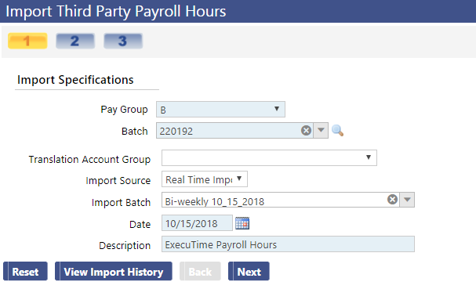
ExecuTime Integration
Import Third Party Payroll Hours
Notes:
Payroll Hours import is the same process as we are all familiar with
Data from executime is stored directly in the software
We added the Import source as a drop box to identify hours from a 3rd party (if using the integration, we will select Real Time Import)
This was done so users can pick the pay batch they want the hours to be paid from. Lastly we will look at a little auditing for the data transfers.

Slide 22
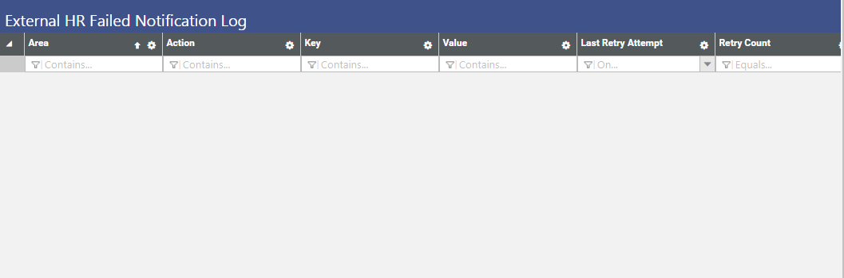
ExecuTime Integration
External HR Failed Notification Log
Notes:
How do I know the update I made in NWERP has really been updated in ExecuTime?
This is our fail safe or redundancy measure.
Notifications will be sent to ET every 30 minutes until accepted.
Email will generate to Administrator the following morning is there is an item that did not get updated in ET

Slide 23
2019.1 Release Enhancements
Mini Payroll Batches
Performance Enhancement – Adding Employee to Payroll Batch
Edit eSuite Change Requests
Add Pay Day Register and One Time Button in Time Entry Screens
Out of Range Date in Time Entry Will Display in Red Text
New Employment Date Report
Exclude “Budget Only” Positions From Open Position Report
Position Budget to Actual Comparison Report

Slide 24
Mini Payroll Batches
Ability to initialize payroll batches with specific filter criteria
Initialize Method
  All Employees
  Department
  Benefit Group
  No Employees
Notes:
What? Added the Initialize Method drop box to the Initialize batch screen. We can initialize a payroll with all employees (current functionality) by department, benefit group, or by no employees. Lets take a look at the new field.

Slide 25
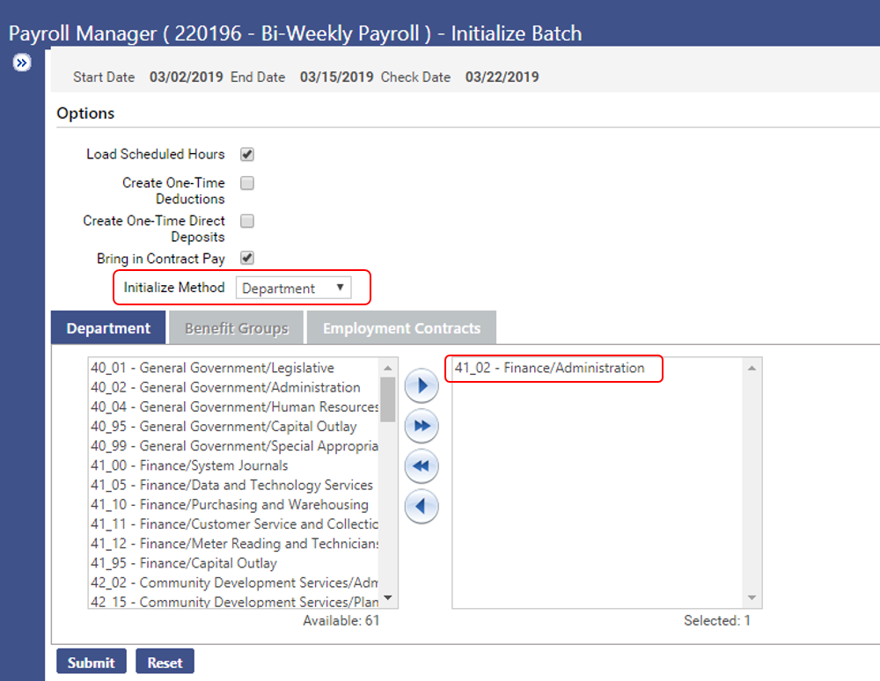
Mini Payroll Batches
Notes:
Here we can see the new fields on the Payroll initialization screen. We have jump boxes for departments and benefit groups, but they do not work in conjunction with each other. Its one ore the other. Here I have one department selected, when I initialize the payroll you will see only this department. Next slide.

Slide 26
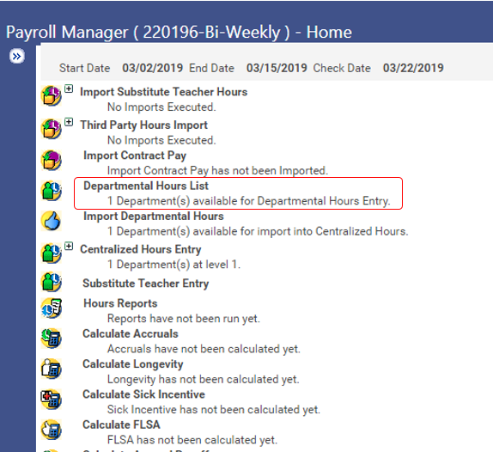
Mini Payroll Batches
Notes:
Why? Select a specific group of employees for a special pay batch. Eliminates the need to initialize all employees and delete the ones we don’t want.
With a regular payroll batch, it allows us the ability to process accruals, longevity, FLSA, and utilize direct deposits as well.
Maybe we want to do a retro pay batch for only one union or benefit group because of a contract negotiation. We now can select just that benefit group instead of having to do multiple manual checks one at a time. Plus the added functionality to process as direct deposits.

Slide 27
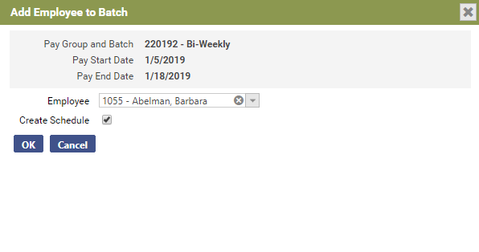
Performance Enhancement – Adding Employee to Payroll Batch
Notes:
Adding Employee to a batch is now much faster than it was in 2018.1

Slide 28
Edit eSuite Change Requests
Added the ability to edit esuite change requests for employee name and address
Typos created by employee submitting request
  Failure to capitalize names (john r doe, main street, etc.)
Naming conventions established by organization
  Abbreviations for address fields (Rd, St, Dr, Blvd, etc.)
Affordable Care Act reporting regulations
  Mailing address character restrictions
Notes:
What? Edit the eSuite change request for Employee Name and Address
Why? See this slide

Slide 29
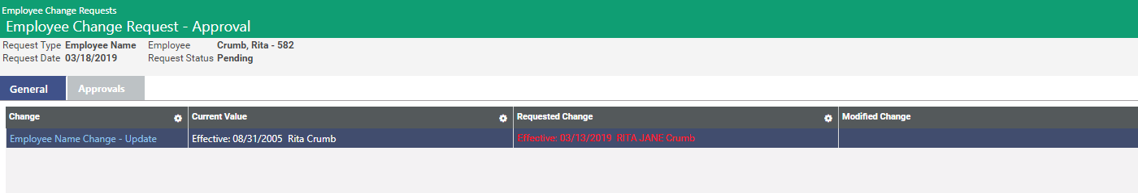
Edit eSuite Change Requests
Added a Modified Change column to Employee Change Request
Notes:
Find eSuite change request. Open the request and you will notice a new column. This is the Modify Change.
In order to make an changes, select the Employee Name Change – Update Hyper link. This will open a popup window.

Slide 30
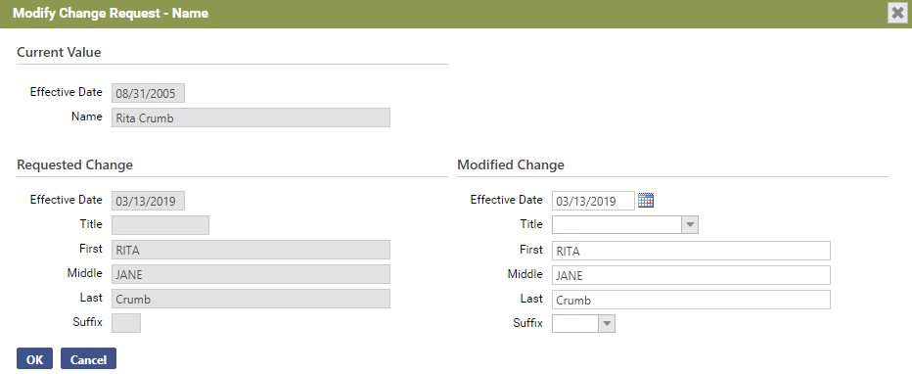
Edit eSuite Change Requests
Select the Employee Name Change Link will open the edit window
Notes:
This popup window will contain the eSuite requested change and a modified change. On the left is what the employee submitted. On the right you see the area you can edit.
Make any changes and hit OK.

Slide 31
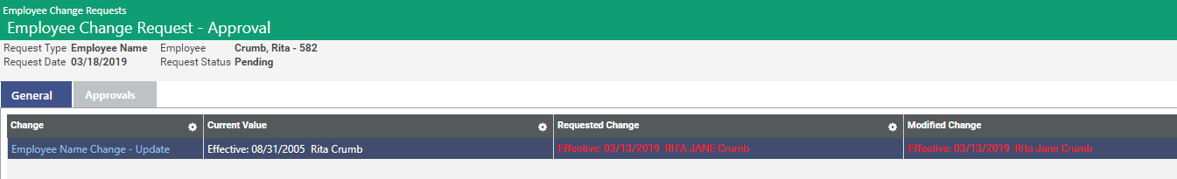
Edit eSuite Change Requests
Enter any changes in the modified section and save the request
Notes:
After edits have been made, you will see the Modified change column now has the values you entered. This is the value that will update workforce.
Modified changes can only occur on a change request that has not been approved or posted. You will be able to open the pop up but the save button is disabled. There is a permission utilized for the edit function in esuite change requests that will allow users to make changes.

Slide 32
Pay Day Register and One Time Buttons in Time Entry
Add one-time processing and register buttons in the hours entry screen within Centralized Hours
Save time with instant access to One Time processing and Pay Day register
Consolidate hours adjustments
Easier auditing for quality assurance
Notes:
What? We added buttons to quick entry and hours code hours entry. A button that directs you to One Time processing and one that will create a payday register for that employee.
Why? In this slide.

Slide 33
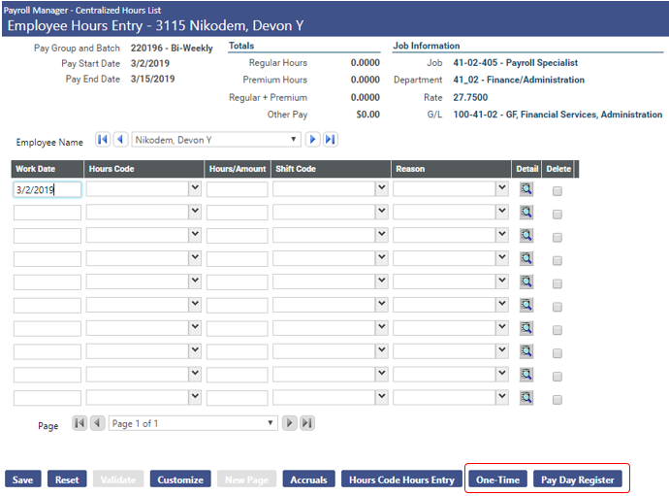
Pay Day Register and One Time Buttons in Time Entry
Notes:
Process of one time and example:
Navigate to one time – Breadcrumb back to centralized hours, select employee, hit One Time, add the one time (now you can get to one time right from time entry.
Pay Day Register – what is the gross, did this calculate correct?
I forgot to do all my One Time’s before starting payroll. This makes it easy to add a one-time on the fly
I’m doing a pay out for vacation/sick time. I want to make sure his check is accurate. Termed EE that owes us vacation time, what will it look like after negative vac hours.

Slide 34
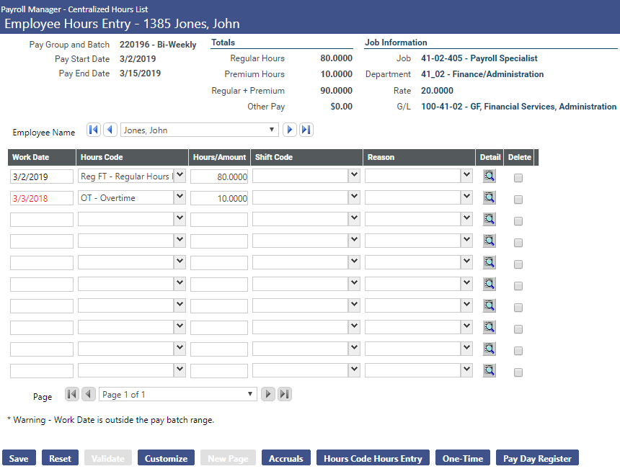
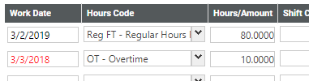
Out of Range Date in Time Entry Displays in Red Text
Notes:
What? Any date that is entered in time entry outside the period begin and end date will show in red.
Why? Easier to identify if a date was keyed in wrong when auditing time entry.
Example

Slide 35
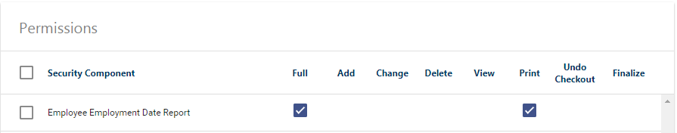
New Employment Date Report
Added a new report called Employee Employment Date Report
Utilizes a new permission
  Employee Employment Date Report
Located under Human Resources – Reports – Employee Reports
Notes:
What? It’s a new report that allows users to find employment dates from the employment data tab easily.
Read slide for more info.

Slide 36
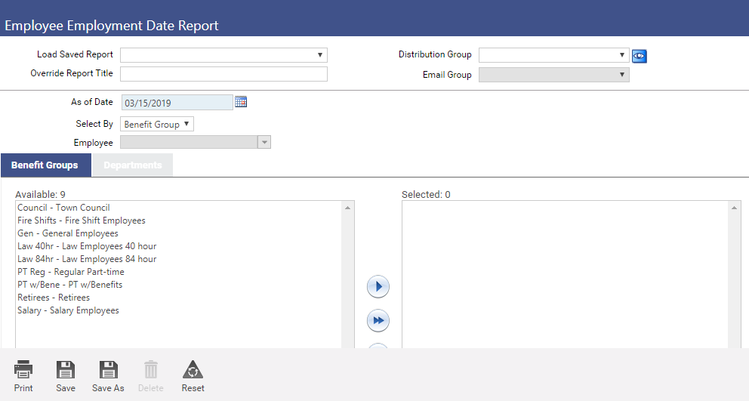
New Employment Date Report
Report Criteria
As of Date
Select By
  Benefit Group, Department or Employee
Appropriate Jump Boxes will be activated
Notes:
What criteria can we select? How did we construct this report?

Slide 37
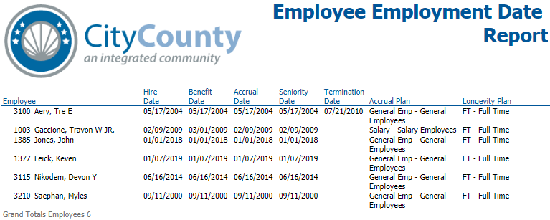
New Employment Date Report - Results
Notes:
Employee – Hire Date – Benefit Date – Accrual Date – Seniority Date – Termination Date – Accrual Plan – Longevity plan
Why? This will help identify years of service and accrual plan for a group of employees at one time. Previously, these dates were found by going to each employee individually in workforce.
Example? Have you ever wanted to know how many employees or what employees are in a particular accrual or longevity plan? Audit this is much easier now. Have you ever set up a new accrual plan and need to verify is employees were receiving accurate accruals. Now you can see the plan and accrual date for the group of employees without needing to go into workforce. This report was created in a linear fashion so it can be easily exported to excel and filtered.

Slide 38
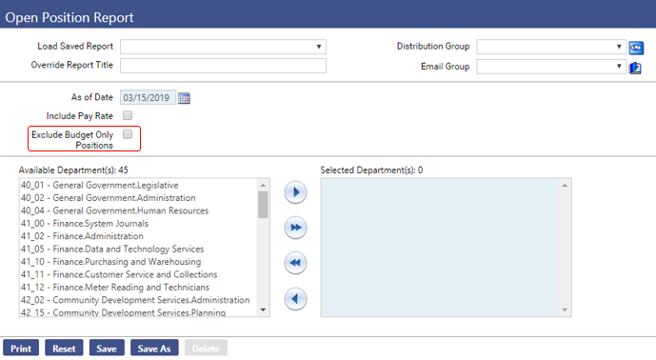
Exclude “Budget Only” Positions From Open Position Report
Human Resources – Reports – Position Control – Open Position Report
Added a new check box labeled “Exclude Budget Only Positions”
Notes:
What – new field added called “Exclude Budget Only Positions” next slide will explain why and an example.

Slide 39


Exclude “Budget Only” Positions From Open Position Report
Notes:
Why? Before the change on top, after the change by excluding budget only bottom
Open position report that is not budget only can be used to identify open FTE’s in your organization where as Budget only positions are not useable FTE’s
Example: I want to know the approved count of ACTUAL FTE’s for a department. This identifies them without needing to remove budget only. (notice the grand total approved count)

Slide 40
Position Budget to Actual Comparison Report
Expenses Budgeted or Paid to:
Positions with an Employee
Position that had 2 different employee’s; not at the same time.
Vacant Positions or Positions with multiple employee’s.
Anyone paid to a position
Human Resources – Reports – Position Control – Position Budget to Actual Comparison Report
Notes:
The Position Budget to Actual Comparison Report makes it easy for you to track the progress of the annual position budget to what was paid in payroll. It also may be used to track the accuracy of the annual position budget calculation.

Slide 41
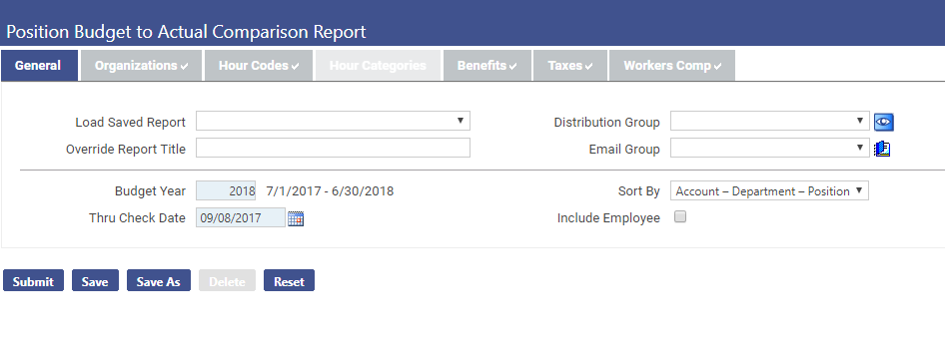
Position Budget to Actual Comparison Report
Budget Year
Thru check date
Org sets
Hours Codes/Categories
Benefits
Taxes
Workers Comp
Notes:
The Position Budget to Actual Comparison Report lets you select (read slide) and may be sorted by Account-Department-Position OR Department Account – Position.
You may include the employee or not.
Permission for this report is “Position Budget to Actual Comparison Report”
The report is located: (mentioned on previous slide)

Slide 42
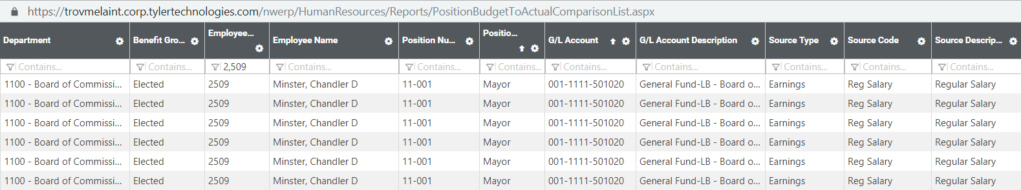
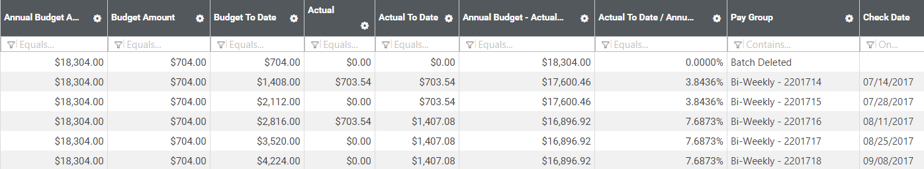
Position Budget to Actual Comparison Report
Notes:
The report breaks down the annual budget calculations per pay batch and the actual amounts paid per position compared to the budgeted amounts.
Using the column filters, you may filter the data as necessary, then click the Feature chooser icon in a column header to export the data to Excel and manage it from there.
Note: Changing the data by filtering will not recalculate the Budget to Date, the Actual to Date or the % Used columns.

Slide 43
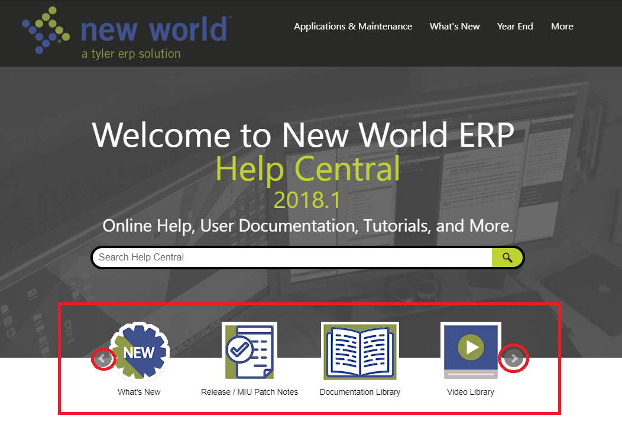
Help Central is web based
https://nwerphelp.tylertech.com/nwerp_help_2018.1/Content/Home.htm
What’s New
Release/MIU Patch Notes
Documentation Library
Video Library
Customer Ideas
Notes:
Help Central is Tyler’s online help for the New World ERP application suite. Clicking the Help icon anywhere within New World ERP will open Help Central, allowing you to view information about the software area in which you are working. From there, you can use the Table of Contents to navigate anywhere within the help system, or the Search tool to find information based on specific search criteria.
Help Central is also the place to go for any and all New World ERP related user documentation. From Update Guides to User/Training Manuals to one-page Quick Reference Sheets and more. Whatever you’re looking for, if it has been documented, you’ll find it in Help Central.
This site is best viewed in the Chrome, Firefox or Edge web browsers.

Slide 44
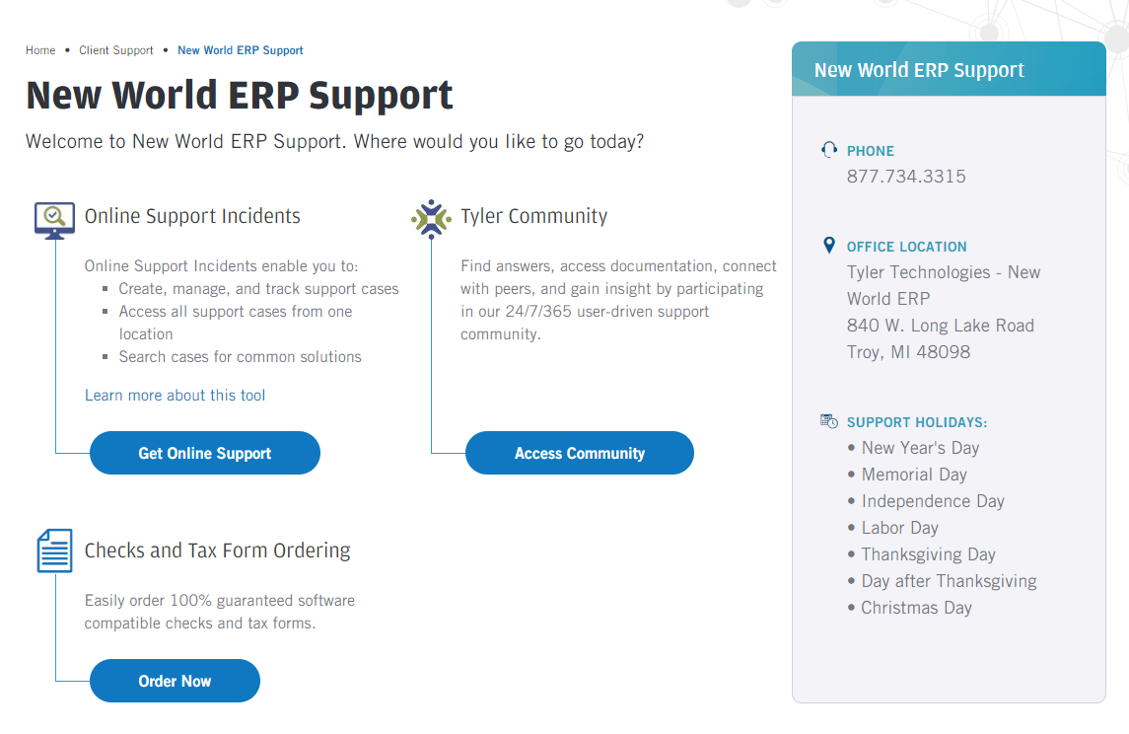
https://www.Tylertech.com
Register/Login
Client Support
Choose your Product
New World ERP Support
Online Support Incidents = Cases
Tyler Community = Access Community
Checks and Tax Form Ordering
Notes:
Online Support Incidents enable you to: Create, manage, and track support cases
Access all support cases from one location
Search cases for common solutions
Find answers, access documentation, connect with peers, and gain insight by participating in our 24/7/365 user-driven support community.

Slide 45
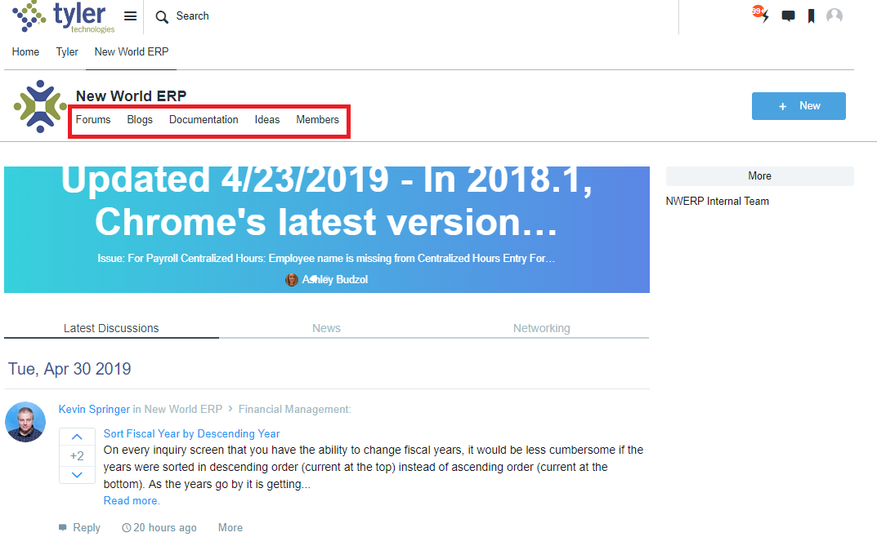
Tyler Community
Forums
Blogs
Documentation
Ideas
Members
Notes:
Banner has the “alerts” from NW Support to Customers
Select the Menu options above the banner for the additional options

Slide 46
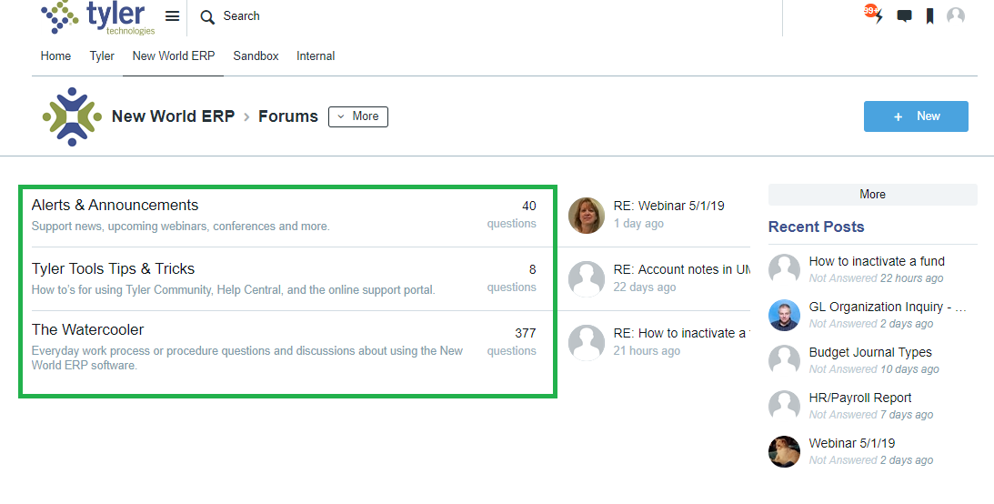
Forums
Alerts & Announcements
Tyler Tools Tips & Tricks
The Water Cooler (customer to customer)
Notes:
Forums- access to deeper details

Slide 47
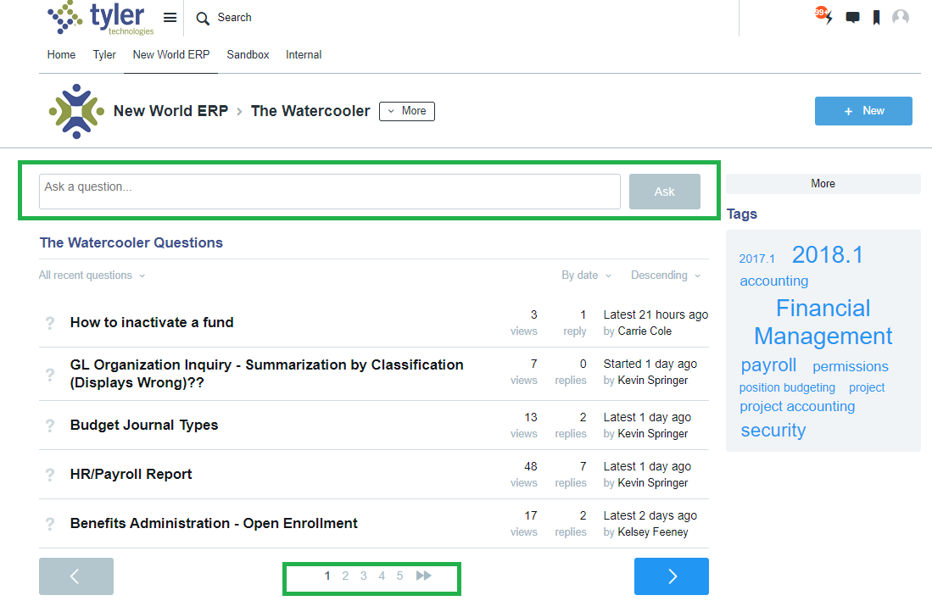
The Water Cooler
Notes:
The Water Cooler is the area where you can ask other NW ERP users- how to’s, short cuts etc.

Slide 48

Questions?

Slide 49

Thank You

